Slide 1
SAMPLING METHODS
‹#›

Slide 2
LEARNING OBJECTIVES
Learn the reasons for sampling
Develop an understanding about different sampling methods
Distinguish between probability & non probability sampling
Discuss the relative advantages & disadvantages of each sampling methods
‹#›

Slide 3
What is research?
“Scientific research is systematic, controlled, empirical, and critical investigation of natural phenomena guided by theory and hypotheses about the presumed relations among such phenomena.”
Kerlinger, 1986
Research is an organized and systematic way of finding answers to questions
‹#›

Slide 4
Important Components of Empirical Research
Problem statement, research questions, purposes, benefits
Theory, assumptions, background literature
Variables and hypotheses
Operational definitions and measurement
Research design and methodology
Instrumentation, sampling
Data analysis
Conclusions, interpretations, recommendations
‹#›
Notes:
‹#›
PROBLEM STATEMENT, PURPOSES, BENEFITS
What exactly do I want to find out?
What is a researchable problem?
What are the obstacles in terms of knowledge, data availability, time, or resources?
Do the benefits outweigh the costs?
THEORY, ASSUMPTIONS, BACKGROUND LITERATURE
What does the relevant literature in the field indicate about this problem?
Which theory or conceptual framework does the work fit within?
What are the criticisms of this approach, or how does it constrain the research process?
What do I know for certain about this area?
What is the background to the problem that needs to be made available in reporting the work?
VARIABLES AND HYPOTHESES
What will I take as given in the environment ie what is the starting point?
Which are the independent and which are the dependent variables?
Are there control variables?
Is the hypothesis specific enough to be researchable yet still meaningful?
How certain am I of the relationship(s) between variables?
OPERATIONAL DEFINITIONS AND MEASUREMENT
Does the problem need scoping/simplifying to make it achievable?
What and how will the variables be measured?
What degree of error in the findings is tolerable?
Is the approach defendable?
RESEARCH DESIGN AND METHODOLOGY
What is my overall strategy for doing this research?
Will this design permit me to answer the research question?
What constraints will the approach place on the work?
INSTRUMENTATION/SAMPLING
How will I get the data I need to test my hypothesis?
What tools or devices will I use to make or record observations?
Are valid and reliable instruments available, or must I construct my own?
How will I choose the sample?
Am I interested in representativeness?
If so, of whom or what, and with what degree of accuracy or level of confidence?
DATA ANALYSIS
What combinations of analytical and statistical process will be applied to the data?
Which of these will allow me to accept or reject my hypotheses?
Do the findings show numerical differences, and are those differences important?
CONCLUSIONS, INTERPRETATIONS, RECOMMENDATIONS
Was my initial hypothesis supported?
What if my findings are negative?
What are the implications of my findings for the theory base, for the background assumptions, or relevant literature?
What recommendations result from the work?
What suggestions can I make for further research on this topic?

Slide 5
SAMPLING
A sample is “a smaller (but hopefully representative) collection of units from a population used to determine truths about that population” (Field, 2005)
Why sample?
Resources (time, money) and workload
Gives results with known accuracy that can be calculated mathematically
The sampling frame is the list from which the potential respondents are drawn
Registrar’s office
Class rosters
Must assess sampling frame errors
‹#›
Notes:
‹#›
Sampling frame errors: university versus personal email addresses; changing class rosters; are all students in your population of interest represented?

Slide 6
SAMPLING……
What is your population of interest?
To whom do you want to generalize your results?
All doctors
School children
Indians
Women aged 15-45 years
Other
Can you sample the entire population?
‹#›
Notes:
‹#›
How do we determine our population of interest?
Administrators can tell us
We notice anecdotally or through qualitative research that a particular subgroup of students is experiencing higher risk
We decide to do everyone and go from there
3 factors that influence sample representativeness
Sampling procedure
Sample size
Participation (response)
When might you sample the entire population?
When your population is very small
When you have extensive resources
When you don’t expect a very high response

Slide 7
SAMPLING…….
3 factors that influence sample representative-ness
Sampling procedure
Sample size
Participation (response)
When might you sample the entire population?
When your population is very small
When you have extensive resources
When you don’t expect a very high response
‹#›

Slide 8
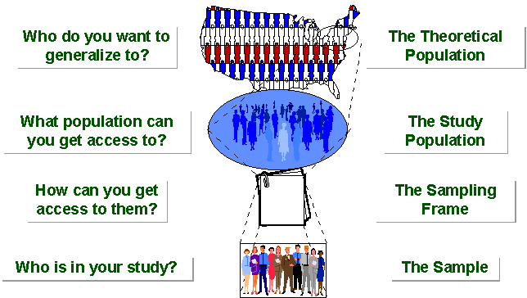
‹#›
SAMPLING BREAKDOWN
Notes:
‹#›
Picture of sampling breakdown

Slide 9
SAMPLING…….
STUDY POPULATION
SAMPLE
TARGET POPULATION
‹#›

Slide 10
Types of Samples
Probability (Random) Samples
Simple random sample
Systematic random sample
Stratified random sample
Multistage sample
Multiphase sample
Cluster sample
Non-Probability Samples
Convenience sample
Purposive sample
Quota
‹#›
Notes:
‹#›
Two general approaches to sampling are used in social science research. With probability sampling, all elements (e.g., persons, households) in the population have some opportunity of being included in the sample, and the mathematical probability that any one of them will be selected can be calculated. With nonprobability sampling, in contrast, population elements are selected on the basis of their availability (e.g., because they volunteered) or because of the researcher's personal judgment that they are representative. The consequence is that an unknown portion of the population is excluded (e.g., those who did not volunteer). One of the most common types of nonprobability sample is called a convenience sample – not because such samples are necessarily easy to recruit, but because the researcher uses whatever individuals are available rather than selecting from the entire population.
Because some members of the population have no chance of being sampled, the extent to which a convenience sample – regardless of its size – actually represents the entire population cannot be known

Slide 11
Process
The sampling process comprises several stages:
Defining the population of concern
Specifying a sampling frame, a set of items or events possible to measure
Specifying a sampling method for selecting items or events from the frame
Determining the sample size
Implementing the sampling plan
Sampling and data collecting
Reviewing the sampling process
‹#›

Slide 12
Population definition
A population can be defined as including all people or items with the characteristic one wishes to understand.
Because there is very rarely enough time or money to gather information from everyone or everything in a population, the goal becomes finding a representative sample (or subset) of that population.
‹#›

Slide 13
Population definition…….
Note also that the population from which the sample is drawn may not be the same as the population about which we actually want information. Often there is large but not complete overlap between these two groups due to frame issues etc .
Sometimes they may be entirely separate - for instance, we might study rats in order to get a better understanding of human health, or we might study records from people born in 2008 in order to make predictions about people born in 2009.
‹#›

Slide 14
SAMPLING FRAME
In the most straightforward case, such as the sentencing of a batch of material from production (acceptance sampling by lots), it is possible to identify and measure every single item in the population and to include any one of them in our sample. However, in the more general case this is not possible. There is no way to identify all rats in the set of all rats. Where voting is not compulsory, there is no way to identify which people will actually vote at a forthcoming election (in advance of the election)
As a remedy, we seek a sampling frame which has the property that we can identify every single element and include any in our sample .
The sampling frame must be representative of the population
‹#›

Slide 15
PROBABILITY SAMPLING
A probability sampling scheme is one in which every unit in the population has a chance (greater than zero) of being selected in the sample, and this probability can be accurately determined.
. When every element in the population does have the same probability of selection, this is known as an 'equal probability of selection' (EPS) design. Such designs are also referred to as 'self-weighting' because all sampled units are given the same weight.
‹#›

Slide 16
PROBABILITY SAMPLING…….
Probability sampling includes:
Simple Random Sampling,
Systematic Sampling,
Stratified Random Sampling,
Cluster Sampling
Multistage Sampling.
Multiphase sampling
‹#›

Slide 17
NON PROBABILITY SAMPLING
Any sampling method where some elements of population have no chance of selection (these are sometimes referred to as 'out of coverage'/'undercovered'), or where the probability of selection can't be accurately determined. It involves the selection of elements based on assumptions regarding the population of interest, which forms the criteria for selection. Hence, because the selection of elements is nonrandom, nonprobability sampling not allows the estimation of sampling errors..
Example: We visit every household in a given street, and interview the first person to answer the door. In any household with more than one occupant, this is a nonprobability sample, because some people are more likely to answer the door (e.g. an unemployed person who spends most of their time at home is more likely to answer than an employed housemate who might be at work when the interviewer calls) and it's not practical to calculate these probabilities.
‹#›

Slide 18
NONPROBABILITY SAMPLING…….
Nonprobability Sampling includes: Accidental Sampling, Quota Sampling and Purposive Sampling. In addition, nonresponse effects may turn any probability design into a nonprobability design if the characteristics of nonresponse are not well understood, since nonresponse effectively modifies each element's probability of being sampled.
‹#›

Slide 19
SIMPLE RANDOM SAMPLING
Applicable when population is small, homogeneous & readily available
All subsets of the frame are given an equal probability. Each element of the frame thus has an equal probability of selection.
It provides for greatest number of possible samples. This is done by assigning a number to each unit in the sampling frame.
A table of random number or lottery system is used to determine which units are to be selected.
‹#›

Slide 20
SIMPLE RANDOM SAMPLING……..
Estimates are easy to calculate.
Simple random sampling is always an EPS design, but not all EPS designs are simple random sampling.
Disadvantages
If sampling frame large, this method impracticable.
Minority subgroups of interest in population may not be present in sample in sufficient numbers for study.
‹#›

Slide 21
REPLACEMENT OF SELECTED UNITS
Sampling schemes may be without replacement ('WOR' - no element can be selected more than once in the same sample) or with replacement ('WR' - an element may appear multiple times in the one sample).
For example, if we catch fish, measure them, and immediately return them to the water before continuing with the sample, this is a WR design, because we might end up catching and measuring the same fish more than once. However, if we do not return the fish to the water (e.g. if we eat the fish), this becomes a WOR design.
‹#›

Slide 22
SYSTEMATIC SAMPLING
Systematic sampling relies on arranging the target population according to some ordering scheme and then selecting elements at regular intervals through that ordered list.
Systematic sampling involves a random start and then proceeds with the selection of every kth element from then onwards. In this case, k=(population size/sample size).
It is important that the starting point is not automatically the first in the list, but is instead randomly chosen from within the first to the kth element in the list.
A simple example would be to select every 10th name from the telephone directory (an 'every 10th' sample, also referred to as 'sampling with a skip of 10').
‹#›

Slide 23
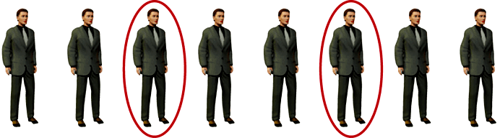
SYSTEMATIC SAMPLING……
As described above, systematic sampling is an EPS method, because all elements have the same probability of selection (in the example given, one in ten). It is not 'simple random sampling' because different subsets of the same size have different selection probabilities - e.g. the set {4,14,24,...,994} has a one-in-ten probability of selection, but the set {4,13,24,34,...} has zero probability of selection.
‹#›

Slide 24
SYSTEMATIC SAMPLING……
ADVANTAGES:
Sample easy to select
Suitable sampling frame can be identified easily
Sample evenly spread over entire reference population
DISADVANTAGES:
Sample may be biased if hidden periodicity in population coincides with that of selection.
Difficult to assess precision of estimate from one survey.
‹#›

Slide 25
STRATIFIED SAMPLING
Where population embraces a number of distinct categories, the frame can be organized into separate "strata." Each stratum is then sampled as an independent sub-population, out of which individual elements can be randomly selected.
Every unit in a stratum has same chance of being selected.
Using same sampling fraction for all strata ensures proportionate representation in the sample.
Adequate representation of minority subgroups of interest can be ensured by stratification & varying sampling fraction between strata as required.
‹#›

Slide 26
STRATIFIED SAMPLING……
Finally, since each stratum is treated as an independent population, different sampling approaches can be applied to different strata.
Drawbacks to using stratified sampling.
First, sampling frame of entire population has to be prepared separately for each stratum
Second, when examining multiple criteria, stratifying variables may be related to some, but not to others, further complicating the design, and potentially reducing the utility of the strata.
Finally, in some cases (such as designs with a large number of strata, or those with a specified minimum sample size per group), stratified sampling can potentially require a larger sample than would other methods
‹#›

Slide 27
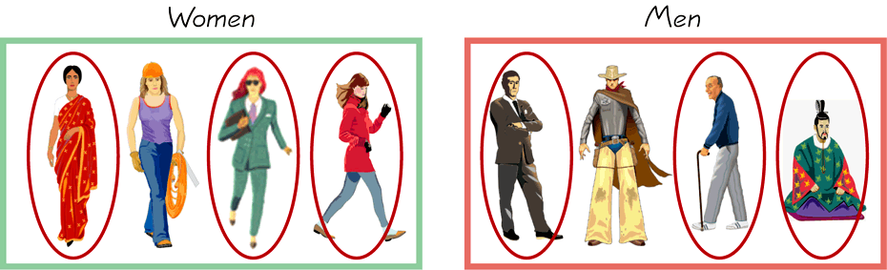
STRATIFIED SAMPLING…….
Draw a sample from each stratum
‹#›

Slide 28
POSTSTRATIFICATION
Stratification is sometimes introduced after the sampling phase in a process called "poststratification“.
This approach is typically implemented due to a lack of prior knowledge of an appropriate stratifying variable or when the experimenter lacks the necessary information to create a stratifying variable during the sampling phase. Although the method is susceptible to the pitfalls of post hoc approaches, it can provide several benefits in the right situation. Implementation usually follows a simple random sample. In addition to allowing for stratification on an ancillary variable, poststratification can be used to implement weighting, which can improve the precision of a sample's estimates.
‹#›

Slide 29
OVERSAMPLING
Choice-based sampling is one of the stratified sampling strategies. In this, data are stratified on the target and a sample is taken from each strata so that the rare target class will be more represented in the sample. The model is then built on this biased sample. The effects of the input variables on the target are often estimated with more precision with the choice-based sample even when a smaller overall sample size is taken, compared to a random sample. The results usually must be adjusted to correct for the oversampling.
‹#›

Slide 30
CLUSTER SAMPLING
Cluster sampling is an example of 'two-stage sampling' .
First stage a sample of areas is chosen;
Second stage a sample of respondents within those areas is selected.
Population divided into clusters of homogeneous units, usually based on geographical contiguity.
Sampling units are groups rather than individuals.
A sample of such clusters is then selected.
All units from the selected clusters are studied.
‹#›

Slide 31
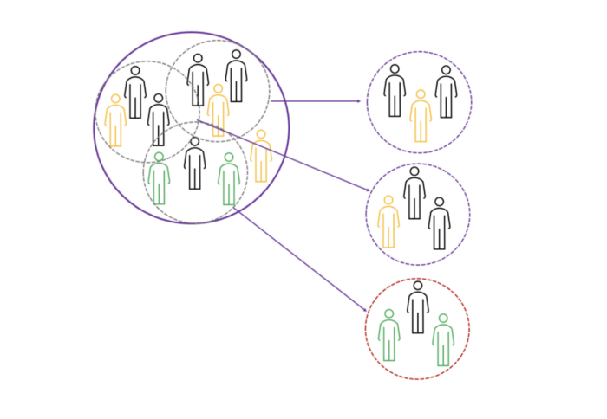

Slide 32
CLUSTER SAMPLING…….
Advantages :
Cuts down on the cost of preparing a sampling frame.
This can reduce travel and other administrative costs.
Disadvantages: sampling error is higher for a simple random sample of same size.
Often used to evaluate vaccination coverage in EPI
‹#›

Slide 33
CLUSTER SAMPLING…….
Identification of clusters
List all cities, towns, villages & wards of cities with their population falling in target area under study.
Calculate cumulative population & divide by 30, this gives sampling interval.
Select a random no. less than or equal to sampling interval having same no. of digits. This forms 1st cluster.
Random no.+ sampling interval = population of 2nd cluster.
Second cluster + sampling interval = 4th cluster.
Last or 30th cluster = 29th cluster + sampling interval
‹#›

Slide 34
CLUSTER SAMPLING…….
Two types of cluster sampling methods.
One-stage sampling. All of the elements within selected clusters are included in the sample.
Two-stage sampling. A subset of elements within selected clusters are randomly selected for inclusion in the sample.
‹#›

Slide 35
CLUSTER SAMPLING…….
Freq c f cluster
I 2000 2000 1
II 3000 5000 2
III 1500 6500
IV 4000 10500 3
V 5000 15500 4, 5
VI 2500 18000 6
VII 2000 20000 7
VIII 3000 23000 8
IX 3500 26500 9
X 4500 31000 10
XI 4000 35000 11, 12
XII 4000 39000 13
XIII 3500 44000 14,15
XIV 2000 46000
XV 3000 49000 16
XVI 3500 52500 17
XVII 4000 56500 18,19
XVIII 4500 61000 20
XIX 4000 65000 21,22
XX 4000 69000 23
XXI 2000 71000 24
XXII 2000 73000
XXIII 3000 76000 25
XXIV 3000 79000 26
XXV 5000 84000 27,28
XXVI 2000 86000 29
XXVII 1000 87000
XXVIII 1000 88000
XXIX 1000 89000 30
XXX 1000 90000
90000/30 = 3000 sampling interval
‹#›

Slide 36
Difference Between Strata and Clusters
Although strata and clusters are both non-overlapping subsets of the population, they differ in several ways.
All strata are represented in the sample; but only a subset of clusters are in the sample.
With stratified sampling, the best survey results occur when elements within strata are internally homogeneous. However, with cluster sampling, the best results occur when elements within clusters are internally heterogeneous
‹#›

Slide 37
MULTISTAGE SAMPLING
Complex form of cluster sampling in which two or more levels of units are embedded one in the other.
First stage, random number of districts chosen in all
states.
Followed by random number of talukas, villages.
Then third stage units will be houses.
All ultimate units (houses, for instance) selected at last step are surveyed.
‹#›

Slide 38
MULTISTAGE SAMPLING……..
This technique, is essentially the process of taking random samples of preceding random samples.
Not as effective as true random sampling, but probably solves more of the problems inherent to random sampling.
An effective strategy because it banks on multiple randomizations. As such, extremely useful.
Multistage sampling used frequently when a complete list of all members of the population not exists and is inappropriate.
Moreover, by avoiding the use of all sample units in all selected clusters, multistage sampling avoids the large, and perhaps unnecessary, costs associated with traditional cluster sampling.
‹#›

Slide 39
MULTI PHASE SAMPLING
Part of the information collected from whole sample & part from subsample.
In Tb survey MT in all cases – Phase I
X –Ray chest in MT +ve cases – Phase II
Sputum examination in X – Ray +ve cases - Phase III
Survey by such procedure is less costly, less laborious & more purposeful
‹#›

Slide 40
MATCHED RANDOM SAMPLING
A method of assigning participants to groups in which pairs of participants are first matched on some characteristic and then individually assigned randomly to groups.
The Procedure for Matched random sampling can be briefed with the following contexts,
Two samples in which the members are clearly paired, or are matched explicitly by the researcher. For example, IQ measurements or pairs of identical twins.
Those samples in which the same attribute, or variable, is measured twice on each subject, under different circumstances. Commonly called repeated measures.
Examples include the times of a group of athletes for 1500m before and after a week of special training; the milk yields of cows before and after being fed a particular diet.
‹#›

Slide 41
QUOTA SAMPLING
The population is first segmented into mutually exclusive sub-groups, just as in stratified sampling.
Then judgment used to select subjects or units from each segment based on a specified proportion.
For example, an interviewer may be told to sample 200 females and 300 males between the age of 45 and 60.
It is this second step which makes the technique one of non-probability sampling.
In quota sampling the selection of the sample is non-random.
For example interviewers might be tempted to interview those who look most helpful. The problem is that these samples may be biased because not everyone gets a chance of selection. This random element is its greatest weakness and quota versus probability has been a matter of controversy for many years
‹#›

Slide 42
CONVENIENCE SAMPLING
Sometimes known as grab or opportunity sampling or accidental or haphazard sampling.
A type of nonprobability sampling which involves the sample being drawn from that part of the population which is close to hand. That is, readily available and convenient.
The researcher using such a sample cannot scientifically make generalizations about the total population from this sample because it would not be representative enough.
For example, if the interviewer was to conduct a survey at a shopping center early in the morning on a given day, the people that he/she could interview would be limited to those given there at that given time, which would not represent the views of other members of society in such an area, if the survey was to be conducted at different times of day and several times per week.
This type of sampling is most useful for pilot testing.
In social science research, snowball sampling is a similar technique, where existing study subjects are used to recruit more subjects into the sample.
‹#›

Slide 43
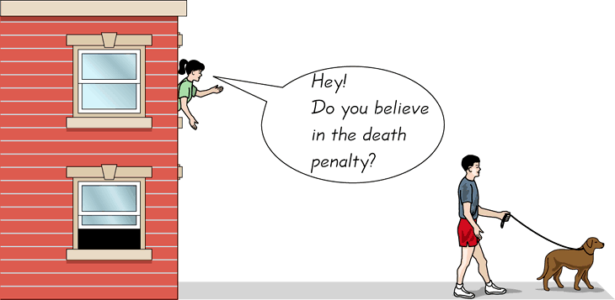
CONVENIENCE SAMPLING…….
Use results that are easy to get
‹#›
‹#›
Notes:
‹#›
‹#›

Slide 44
Judgmental sampling or Purposive sampling
- The researcher chooses the sample based on who they think would be appropriate for the study. This is used primarily when there is a limited number of people that have expertise in the area being researched
‹#›

Slide 45
PANEL SAMPLING
Method of first selecting a group of participants through a random sampling method and then asking that group for the same information again several times over a period of time.
Therefore, each participant is given same survey or interview at two or more time points; each period of data collection called a "wave".
This sampling methodology often chosen for large scale or nation-wide studies in order to gauge changes in the population with regard to any number of variables from chronic illness to job stress to weekly food expenditures.
Panel sampling can also be used to inform researchers about within-person health changes due to age or help explain changes in continuous dependent variables such as spousal interaction.
There have been several proposed methods of analyzing panel sample data, including growth curves.
‹#›

Slide 46

Questions???
‹#›

Slide 47
What sampling method u recommend?
Determining proportion of undernourished five year olds in a village.
Investigating nutritional status of preschool children.
Selecting maternity records for the study of previous abortions or duration of postnatal stay.
In estimation of immunization coverage in a province, data on seven children aged 12-23 months in 30 clusters are used to determine proportion of fully immunized children in the province.
Give reasons why cluster sampling is used in this survey.
‹#›

Slide 48
In some cases the sample designer has access to an "auxiliary variable" or "size measure", believed to be correlated to the variable of interest, for each element in the population. This data can be used to improve accuracy in sample design. One option is to use the auxiliary variable as a basis for stratification, as discussed above.
Another option is probability-proportional-to-size ('PPS') sampling, in which the selection probability for each element is set to be proportional to its size measure, up to a maximum of 1. In a simple PPS design, these selection probabilities can then be used as the basis for Poisson sampling. However, this has the drawbacks of variable sample size, and different portions of the population may still be over- or under-represented due to chance variation in selections. To address this problem, PPS may be combined with a systematic approach.
Probability proportional to size sampling
‹#›

Slide 49
Contd.
Example: Suppose we have six schools with populations of 150, 180, 200, 220, 260, and 490 students respectively (total 1500 students), and we want to use student population as the basis for a PPS sample of size three. To do this, we could allocate the first school numbers 1 to 150, the second school 151 to 330 (= 150 + 180), the third school 331 to 530, and so on to the last school (1011 to 1500). We then generate a random start between 1 and 500 (equal to 1500/3) and count through the school populations by multiples of 500. If our random start was 137, we would select the schools which have been allocated numbers 137, 637, and 1137, i.e. the first, fourth, and sixth schools.
The PPS approach can improve accuracy for a given sample size by concentrating sample on large elements that have the greatest impact on population estimates. PPS sampling is commonly used for surveys of businesses, where element size varies greatly and auxiliary information is often available - for instance, a survey attempting to measure the number of guest-nights spent in hotels might use each hotel's number of rooms as an auxiliary variable. In some cases, an older measurement of the variable of interest can be used as an auxiliary variable when attempting to produce more current estimates.
‹#›

Slide 50
Event sampling
Event Sampling Methodology (ESM) is a new form of sampling method that allows researchers to study ongoing experiences and events that vary across and within days in its naturally-occurring environment. Because of the frequent sampling of events inherent in ESM, it enables researchers to measure the typology of activity and detect the temporal and dynamic fluctuations of work experiences. Popularity of ESM as a new form of research design increased over the recent years because it addresses the shortcomings of cross-sectional research, where once unable to, researchers can now detect intra-individual variances across time. In ESM, participants are asked to record their experiences and perceptions in a paper or electronic diary.
There are three types of ESM:# Signal contingent – random beeping notifies participants to record data. The advantage of this type of ESM is minimization of recall bias.
Event contingent – records data when certain events occur
‹#›

Slide 51
Contd.
Event contingent – records data when certain events occur
Interval contingent – records data according to the passing of a certain period of time
ESM has several disadvantages. One of the disadvantages of ESM is it can sometimes be perceived as invasive and intrusive by participants. ESM also leads to possible self-selection bias. It may be that only certain types of individuals are willing to participate in this type of study creating a non-random sample. Another concern is related to participant cooperation. Participants may not be actually fill out their diaries at the specified times. Furthermore, ESM may substantively change the phenomenon being studied. Reactivity or priming effects may occur, such that repeated measurement may cause changes in the participants' experiences. This method of sampling data is also highly vulnerable to common method variance.[6]
‹#›

Slide 52
contd.
Further, it is important to think about whether or not an appropriate dependent variable is being used in an ESM design. For example, it might be logical to use ESM in order to answer research questions which involve dependent variables with a great deal of variation throughout the day. Thus, variables such as change in mood, change in stress level, or the immediate impact of particular events may be best studied using ESM methodology. However, it is not likely that utilizing ESM will yield meaningful predictions when measuring someone performing a repetitive task throughout the day or when dependent variables are long-term in nature (coronary heart problems).
‹#›

